Slide 1

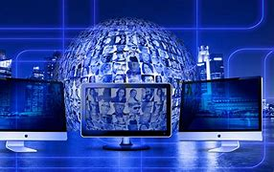

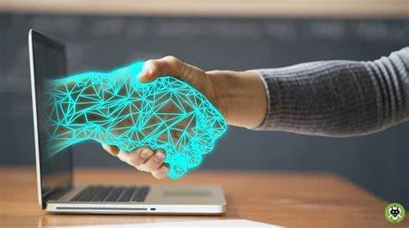
presented by
shreya verma ,
b.sc.sem-1 c.s.
IMPACTS OF COMPUTER TECHNOLOGY

Slide 2


TABLE OF CONTENTS
introduction
what is computer technoplogy ?
impacts of computer technology on various fields
positive impacts
negative impacts
conclusion

Slide 3
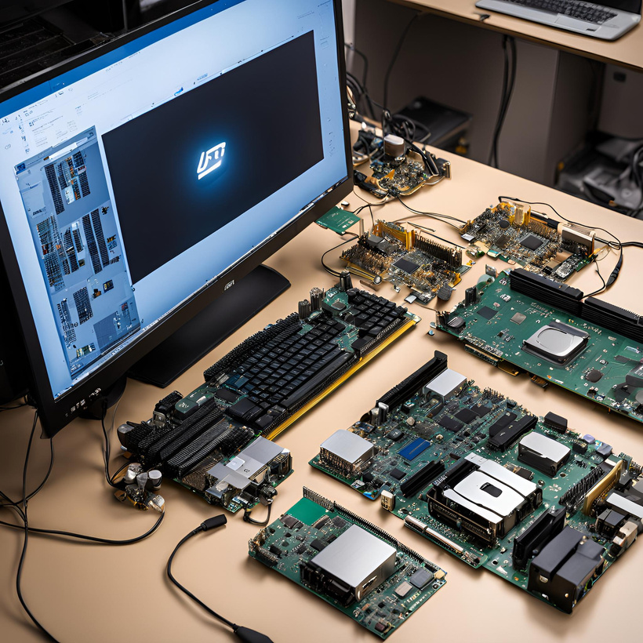
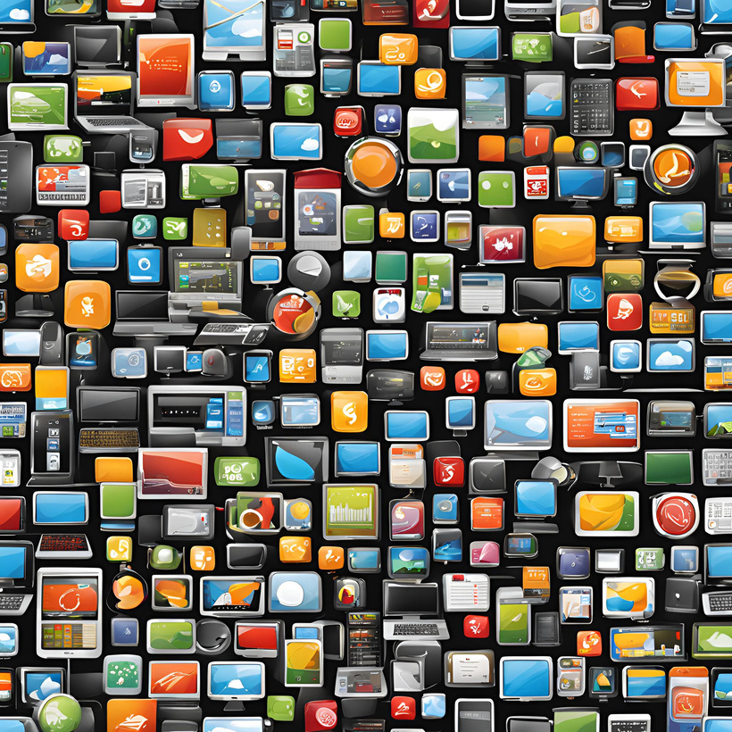



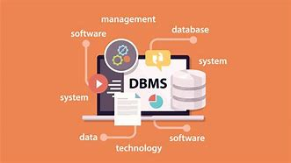
what is a computer technology?
computer technology refers to tools,systems and methods used to create,manage,process information with computer or related devices. it includes a wide range of decipline and application.
hardware
software
programming
cloud computing
cyber security
database managemant

Slide 4

FIELDS IN WHICH COMPUTER TECHNOLOGY IMPACTS
health
care
research
education
communication
fields
education
transport
ation
buisness
entertain
ment

Slide 5

positive impacts of computer technology

Slide 6



diagnosis
improved patient care
health
care
telemedicine
electronic health records
medical imaging

Slide 7



Education
Access to Infinite Resources and Information
Enhanced Student Engagement and Motivation
Support for Personalized Learning
Development of Digital Literacy Skills
Increased Teacher Productivity and Innovation
Accessibility for Students with Disabilities
Cost-Effectiveness and Resource Efficiency

Slide 8





Easier Sharing
communication
Wider Audience
Faster and Reliable
use of application
Reduced Language Barriers

Slide 9
negative impacts of computer technology

Slide 10



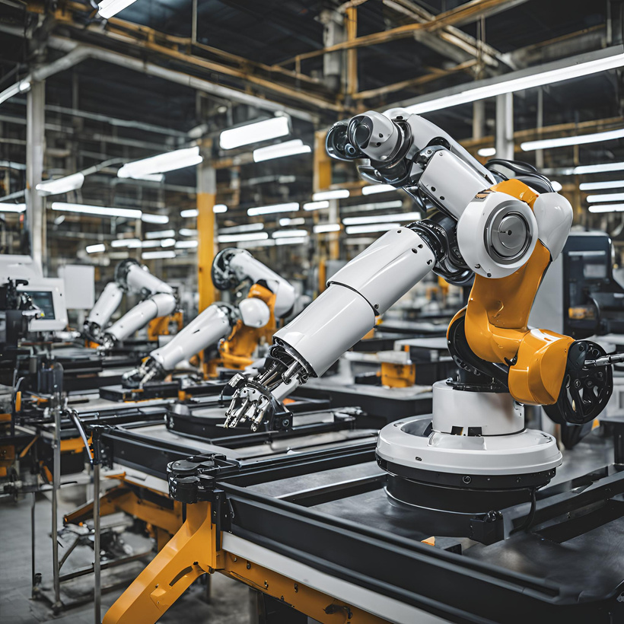

digital footprints
datatheft
e-wastage
cybersecurity threats
job displacement
impersonation

Slide 11

Screen Time and Health
Inequities in
Technology Use:
Impaired
Cognitive
Development
health
care
education
Impact on Social Skills:
High Costs
Addiction and
Dependency
Technical Issues
and Reliability
Sleep Disruption
Content Exposure

Slide 12
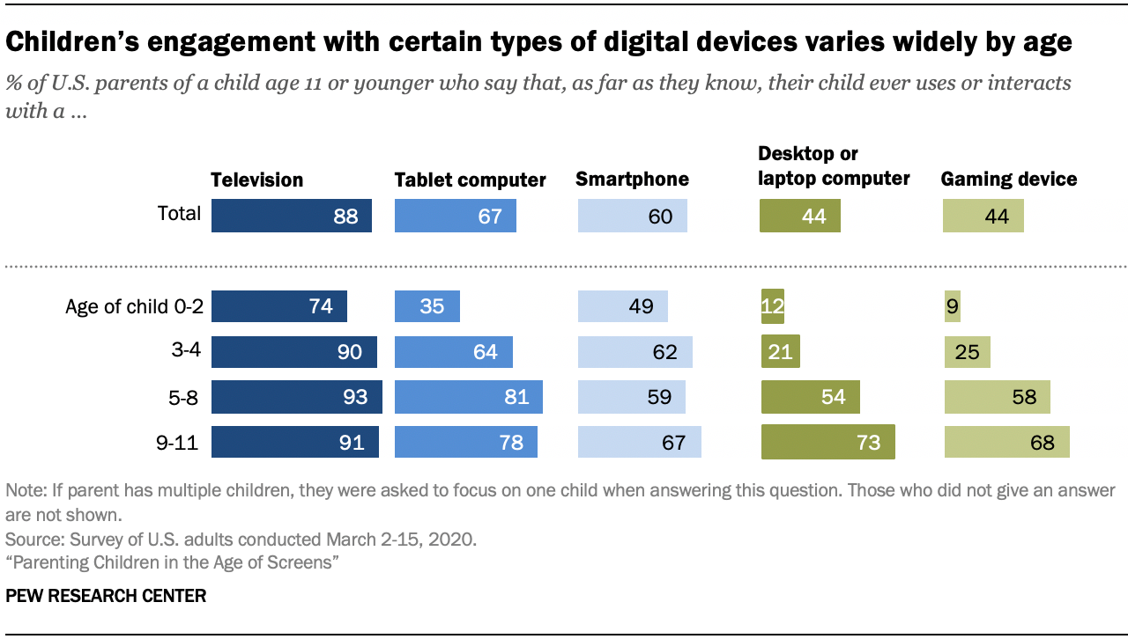

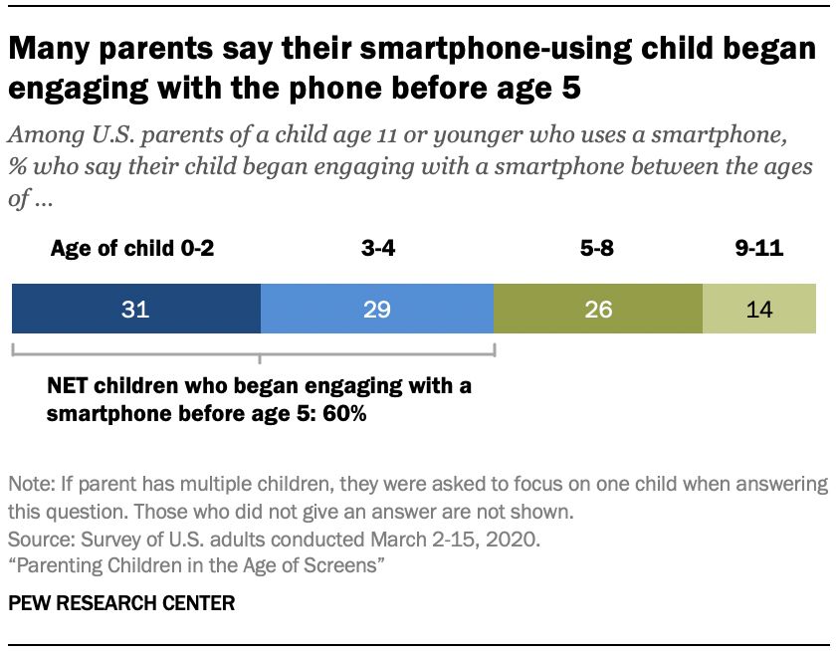
children below 11 years engaged in smartphones

Slide 13
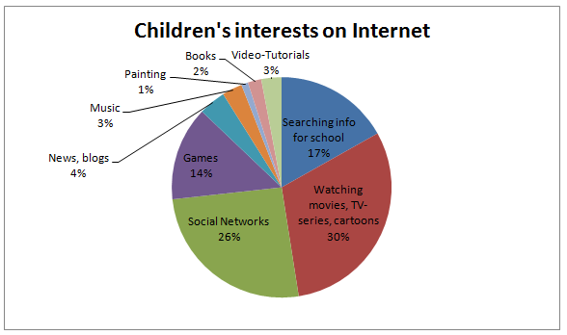

Slide 14
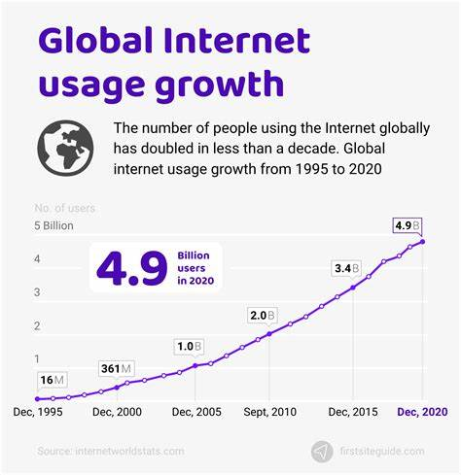
conclusion
computer technology has greatly modified the society, offering significant advancements and opportunities in various fields. It has brought a drastic change in the fields of communication, improved access to information, and enabled great innovations in fields like healthcare, education, and business. However, these benefits come with notable challenges.
There is a day by day increase in the use of internet as it has become a part of our daily life
As shown in the graph.

Slide 15
To control and make use of the positive potential of computer technology while reducing or to put an end to its adverse effects, society must prioritize ethical practices, promote digital literacy, and ensure that technological advancements are access to everyone and beneficial for all. A balanced approach that maintains technological innovation with mindful consideration of its implications can help in creating a future where technology continues to enhance, rather than detract from, the well-being and progress of individuals and communities.

